Slide 1

Pointers and Memory in C++
A beginner’s guide - by Steven Gabarró

Slide 2
Slides and Examples…
They can all be found at
https://github.com/bewchabbacc/pointers
Note that all examples include “helpers.h” which contains a function printing the address and content of a variable
The header also contains
#include <iostream> using namespace std;
Note that the “using” line has been placed in the header to make the examples shorter to read. It is usually a bad idea to include it in the global scope, and should be kept at the file level…

Slide 3
Virtual Memory - A refresher
Each process has access to its own “virtual memory”, starting at address 0, mapped to physical memory by the OS
Virtual Memory is typically organized as (this may vary slightly depending on architecture/OS):
OS/Architecture-Dependent Region (Off-limits)
Text (aka your compiled code)
Data (Initialized global and static data)
BSS (Block Started by Symbol - Uninitialized static/global data)
Heap (or Free memory, growing up)
Large empty space (Dynamic libraries are loaded in here)
Stack (growing down)
OS/Architecture-Dependent Region

Slide 4
The Heap
The heap, or free store, is an area of memory that is shared throughout a process
Data (variables / objects) stored in it can be read as long as the address of it is known
Grows and shrinks by allocating / deallocating data (more on that later)

Slide 5
The Stack
This is an area of memory that contains your stack frames (or Execution Block, or Activation Record)
Each function call creates a new stack frame containing
The parameters sent to the function
The local variables of that function
Control data such as a reference to the previous stack frame and the return address
It grows with each function call, and shrinks on each return

Slide 6
What is a pointer?
Simply put: It is the address of something
Pointers are typically the size of registers in your processor (4B in 32bit processors, 8B in 64bit)
You can have pointers to:
Primitive type variables
Objects
Other pointers
Or pointers to pointers
Or pointers to pointers to pointers
etc…
Functions
Essentially, anything

Slide 7

Pointer Syntax
To declare a pointer:
type *var; // or type* var;
Ideally, initialize pointers with NULL if unsure about what to store in it
type *var = NULL;
You can retrieve the address of any variable with the & symbol
int a = 42; int *pi = &a; // pi now holds the address of pi
You can access the block pointed var by dereferencing it
*var = 5;
a == 42
pi

Slide 8
Common Issues
Do NOT assume pointers get initialized automatically with a 0, so you should ALWAYS give it a value (e.g. NULL (or nullptr in C++11))
Understand the difference between
type *a, b, c; AND type* a, b, c;
In essence, NEVER do type * a, b, c;

Slide 9
Proper uses of * (other than multiplications)
type *symbol
Declaration of a pointer (also used in function parameter declarations)
int *pi = NULL;
void f(int *pi) { … }
type*
Used when declaring (but not implementing) methods (or during type casting)
void f(char*);
*var
Used to dereference a pointer (or reading what the pointer points to)
Note that the size read will depend on the type of the pointer!
*pi = 5; // copies 5 into the integer block pointed by pi
type (*name) (params…)
Function pointers, try to avoid them unless absolutely necessary
int (*operation)(int, int);

Slide 10
Proper uses of &
&var
Get the address of the variable var
type& var
Used in function declarations to specify var is sent by reference
void f(int& var) { … }
var1 & var2
Binary “and” operation between two variables
expr1 && expr2
Logical “and” between two expressions

Slide 11
What NOT to do…
&&var
This would mean get the address of the address of var
In reality it’s nonsense!
Note: This is not the same as the && used in the C++11 “move” operator
*(&var)
That would mean dereference the address of var
That’s silly, just use var…
int *pi = (int*)5;
While technically possible, this would mean that pi is now a pointer to the memory address 5!!! This would result in unpredictable code, and luckily most compilers will warn you about it
Dereferencing a Bad pointer
Returning the address of a Stack variable (compilers will complain about it)

Slide 12
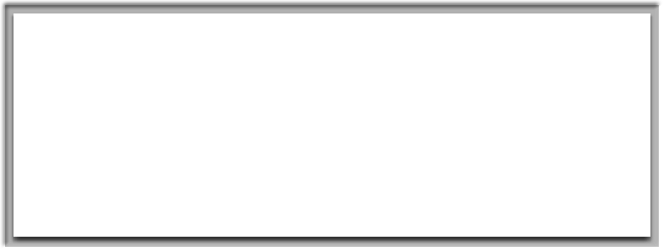
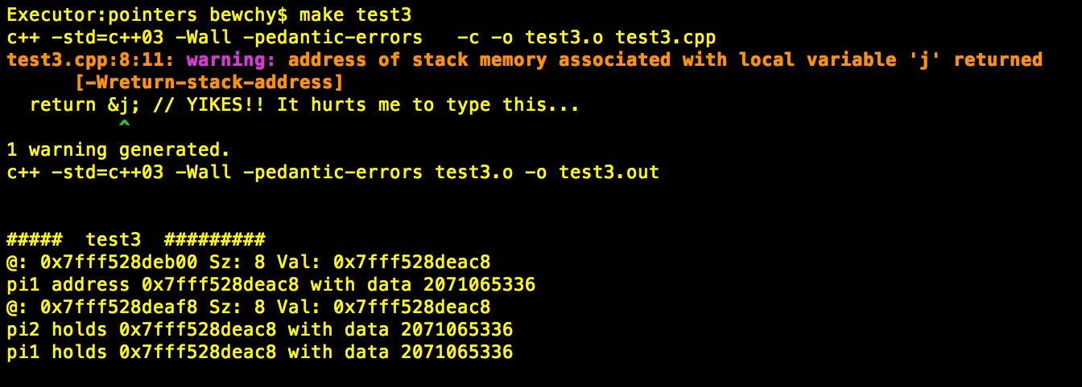
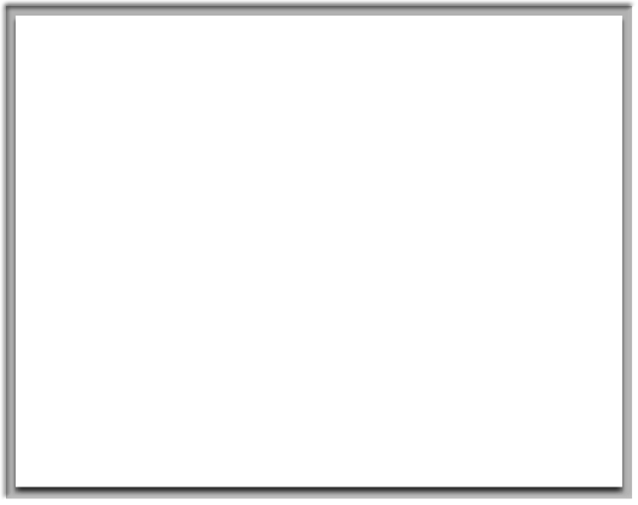
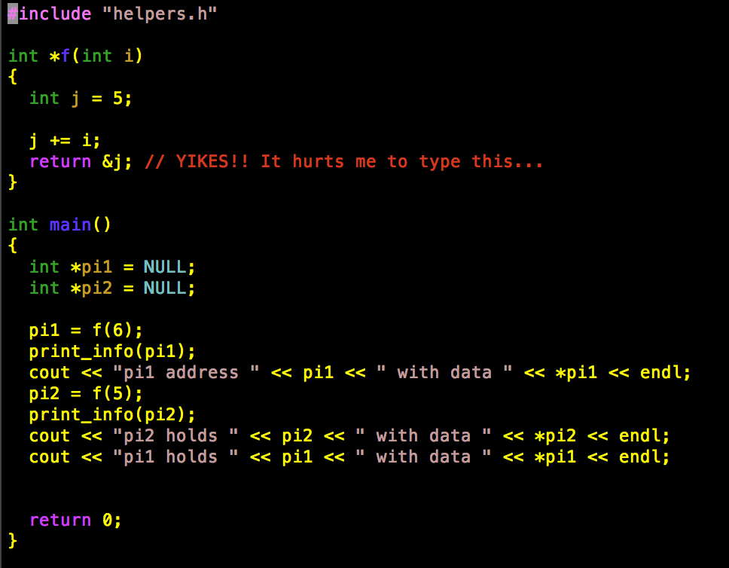

Slide 13


What is a bad pointer?
Cristobal Colon statue in Barcelona (on the opening slide)
He should be pointing to the Americas, but instead…

Slide 14
But really: What is a Bad Pointer?
Pointer pointing to an area that you are not in control of
Best case scenario, it’s an area protected by the OS and you will get a segmentation fault when attempting to dereference the pointer
Worst case scenario, you just played around with a block of memory that was holding something important needed elsewhere in your code (yikes!)

Slide 15
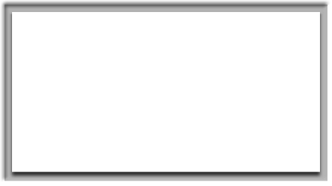

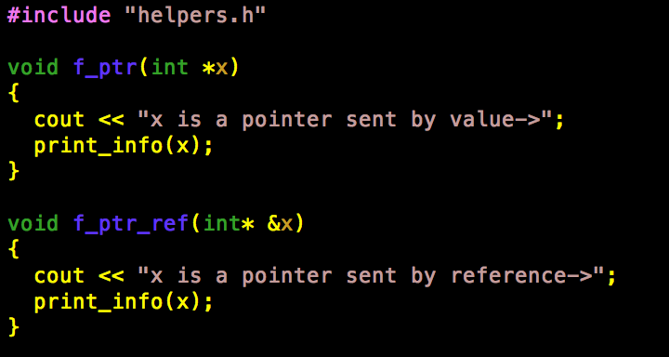
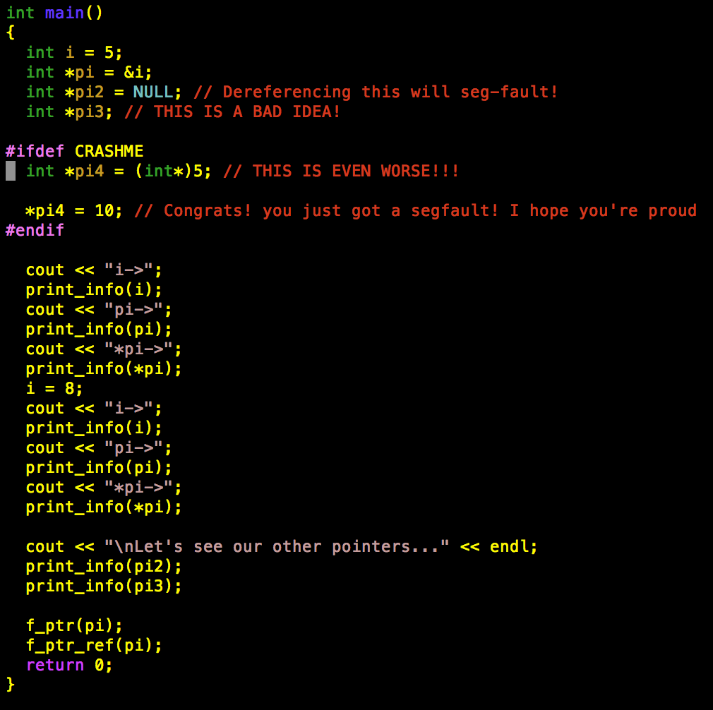
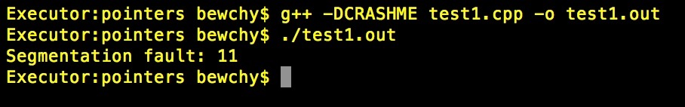
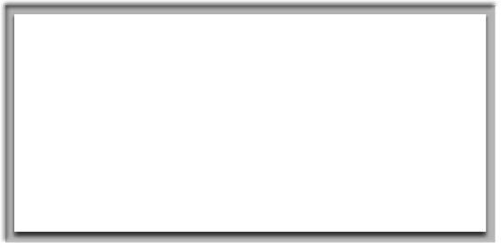
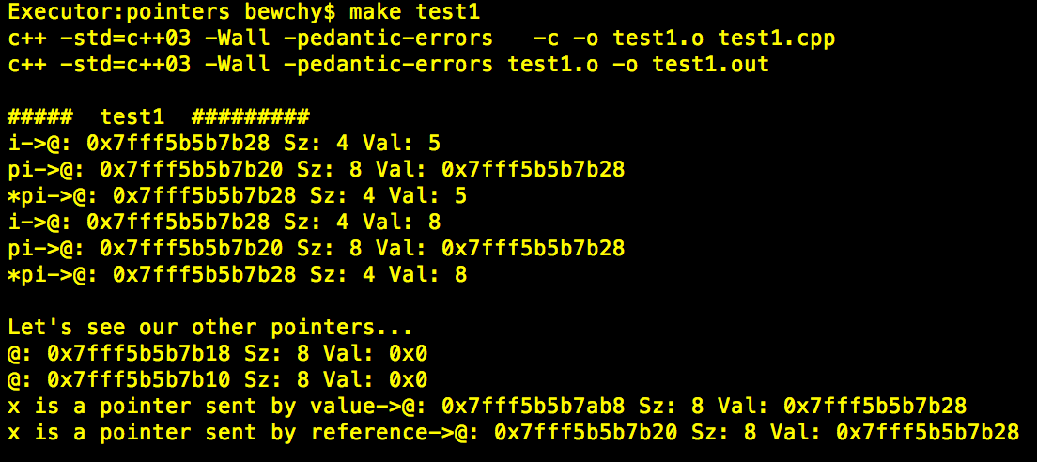

Slide 16
Beware of pointer arithmetic!
Note that basic operations may not behave as you expect
ptr = ptr2
Copies the data in the pointer, which is an address!
Does not copy the data pointed by the pointers
ptr++ or ++ptr
Increments the pointer by sizeof(*ptr) NOT just 1 (unless it is a char*)
e.g.
int *ptr = &i; ++ptr;
Now ptr is pointing sizeof(int) bytes AFTER i
*(ptr++) and (*ptr)++
*(ptr++) will dereference the pointer ptr, then increment it by sizeof(*ptr)
(*ptr)++ will increment the data pointer by the pointer

Slide 17
The new and delete keywords
While you can always get the address of something, you typically want the address of something that is NOT in the stack
In order to put things in the Heap, we use new, to remove them we use delete
int *pi = new int;
This creates a new block that can hold an integer in the Heap, and returns the address to pi
While similar to C’s malloc, they are not interchangeable (especially when allocating objects, as new calls constructors but malloc doesn’t)
delete pi;
This marks the Heap block pointed by pi as free
This is similar to C’s free, but not interchangeable (this will call object destructors)

Slide 18

EXTREMELY IMPORTANT!
DO NOT free SOMETHING ALLOCATED WITH new
DO NOT delete SOMETHING ALLOCATED WITH malloc
DO NOT free NOR delete THE SAME THING TWICE
DO NOT free NOR delete A STACK VARIABLE

Slide 19

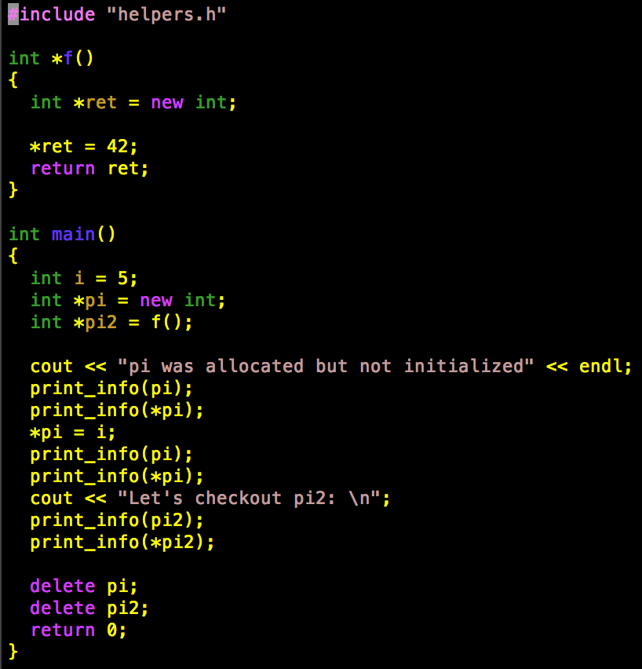

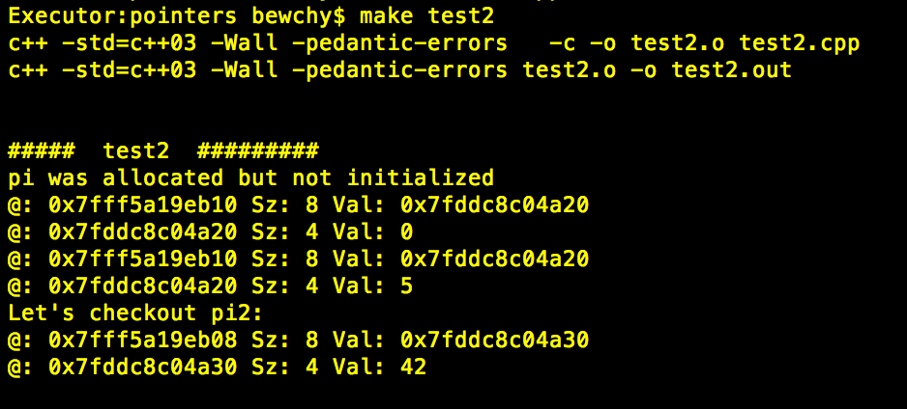

Slide 20
BEWARE!
If you do not free a pointer and lose track of where it is, you just caused a memory leak
This means you now have a reserved block of memory in the heap you have lost track of, taking up space for no reason
e.g.
int i = 42;// makes a local block int *pi = new int; // allocates a heap block pi = &i; // overwrites the heap pointer with the address of the local i

Slide 21
Basic arrays
Arrays are a contiguous block of memory holding data of a certain type
The “name” of the array is in fact a pointer to the first byte of that block
When you do arr[i] it is the same as doing
*(arr + (i * sizeof(*arr)))
or (arr+(i*sizeof(arr[0])))[0]
This means that it is technically legal to do arr[-1] but DO NOT DO IT!

Slide 22
delete[ ] and new[ ]
In order to allocate a “raw” array of type T, you can do
T arr[n]; // this puts the array in the stack
T arr[] = {data1, data2, data3, …};
T *arr2 = new T[n]; // this puts the array in the heap
Only put arrays in the heap if they may be needed outside the scope of your function
Better yet, use containers (see later on)
To delete an array from the Heap, use delete [ ]
delete [] arr2;
Do NOT delete [ ] stack arrays
Do NOT forget the [ ] when deleting arrays!

Slide 23

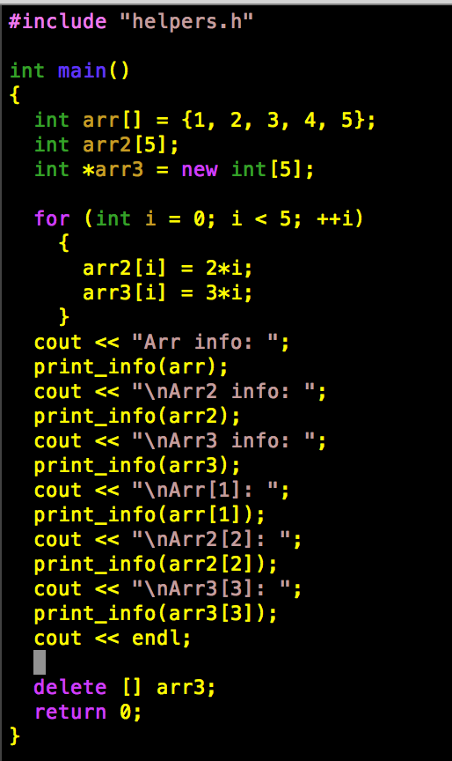
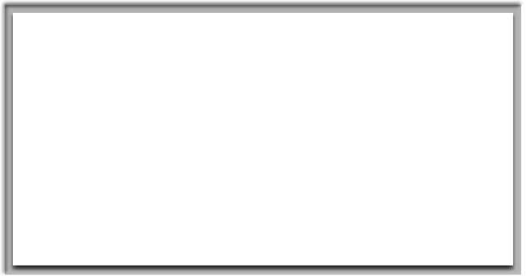
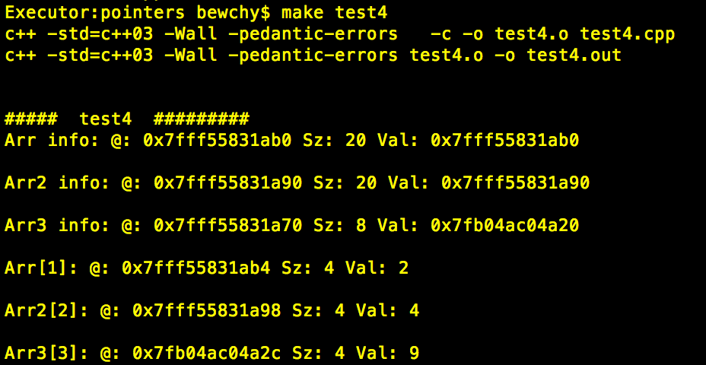

Slide 24
Allocating Objects: constructors and destructors
When you create an object from a class, its constructor gets called
When it is destroyed, the destructor is called
If your object is in the Stack, constructor is called when you create it, the destructor is called when you “fall out of scope”
If you want your object to be in the Heap, constructor/destructor will be called when you do new/delete
To access data members and methods of a Stack object do
obj.method()
To access data members and methods through a pointer to an object you could do
(*obj).method() // UGLY!
obj->method() // NICER!

Slide 25


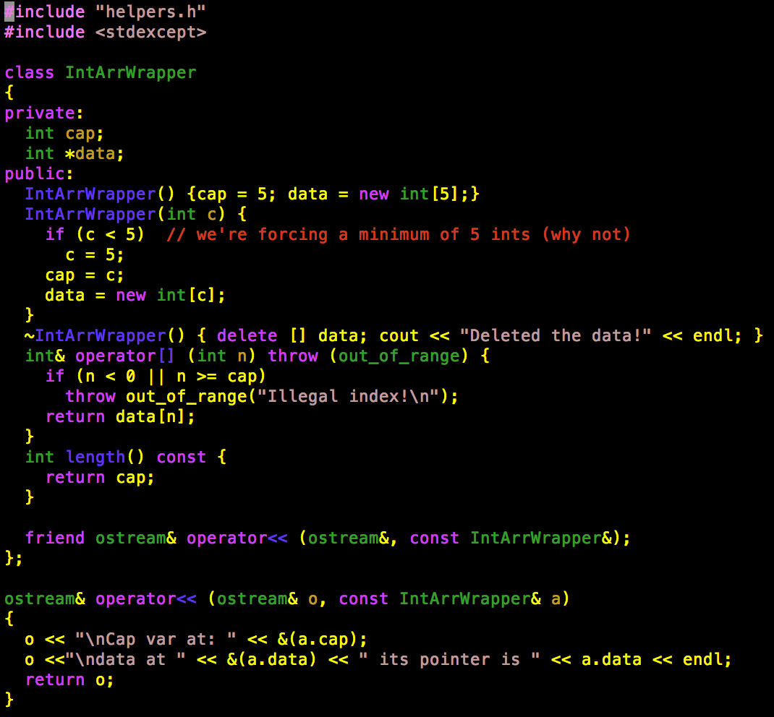
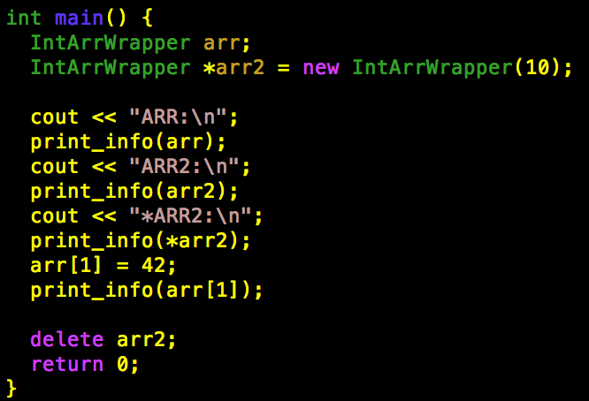

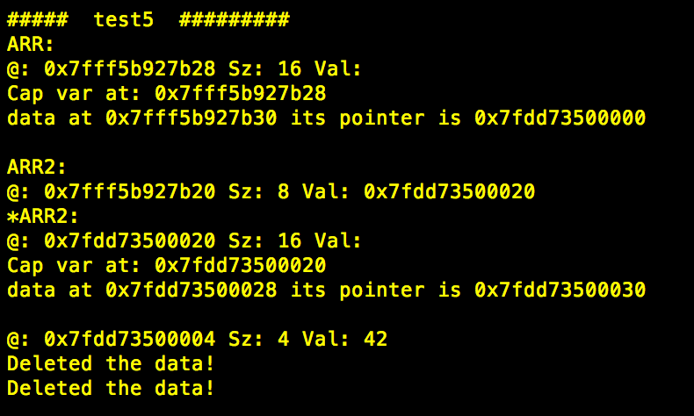

Slide 26
Inheritance and Object Allocation
If you are using inheritance be aware of constructor and destructor call order
The topmost constructor in the class hierarchy is called first, working its way down to the object you constructed
Destructors are called in reverse order (from lowest in the hierarchy, working up through the ancestors)

Slide 27


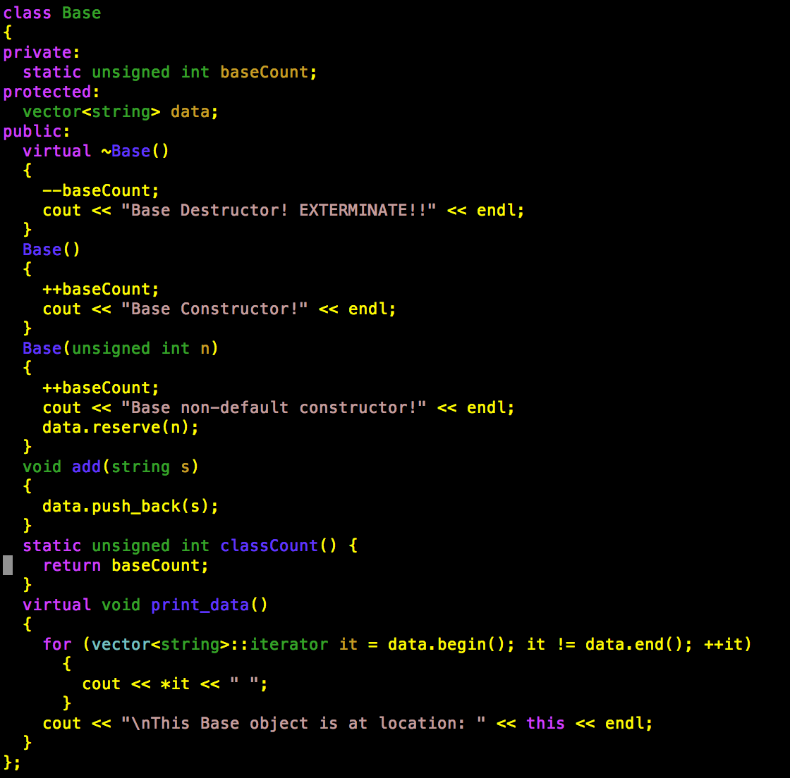
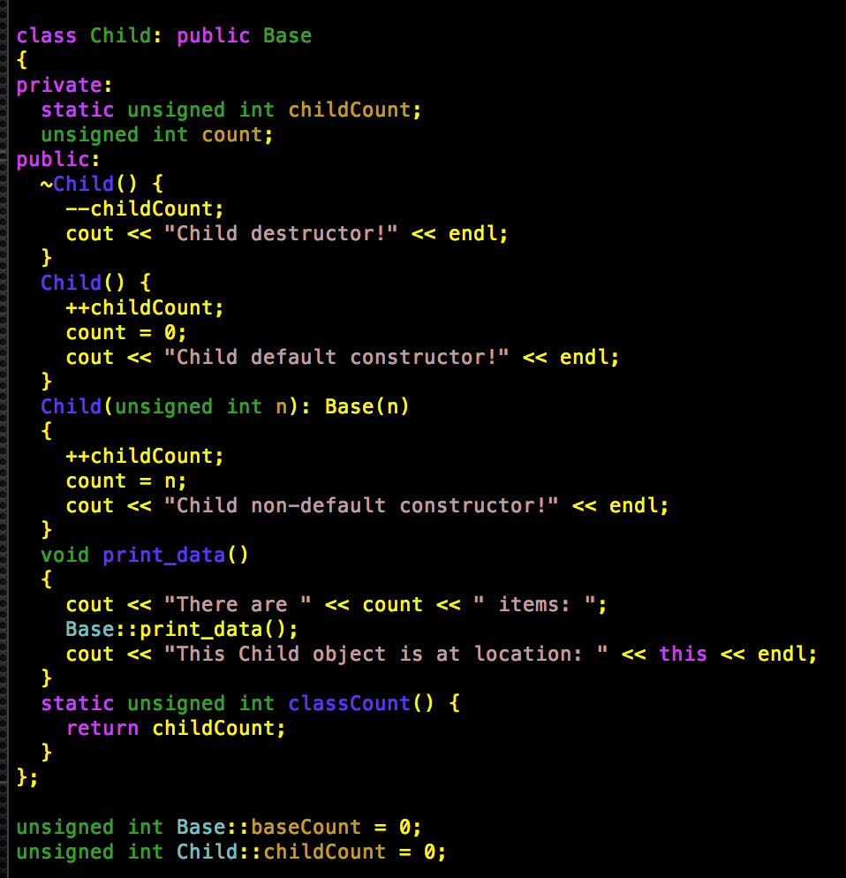

Slide 28

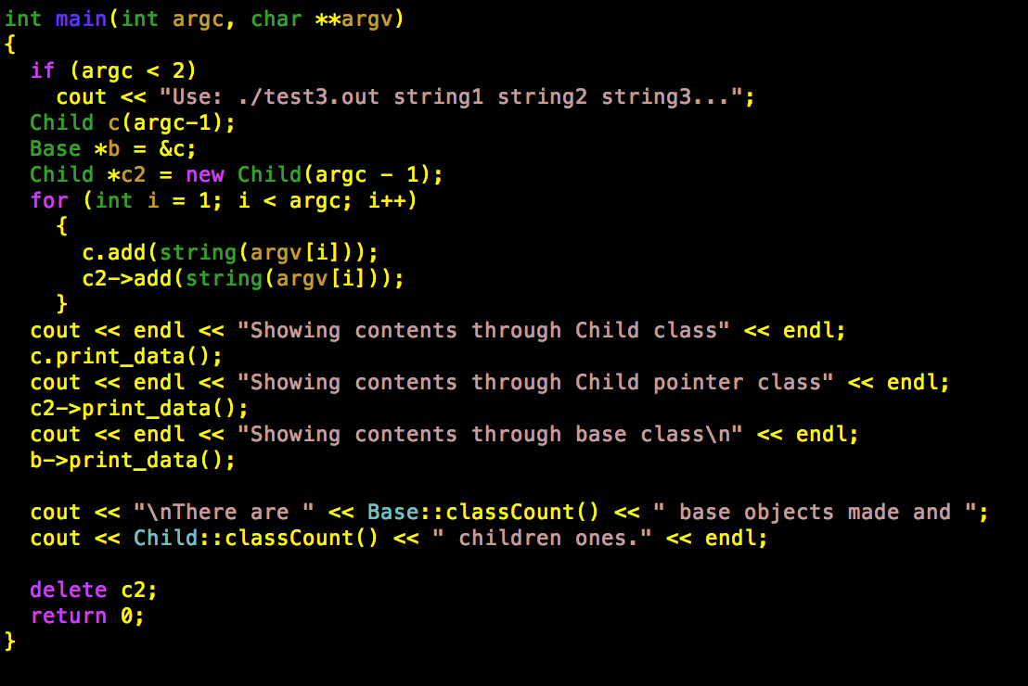

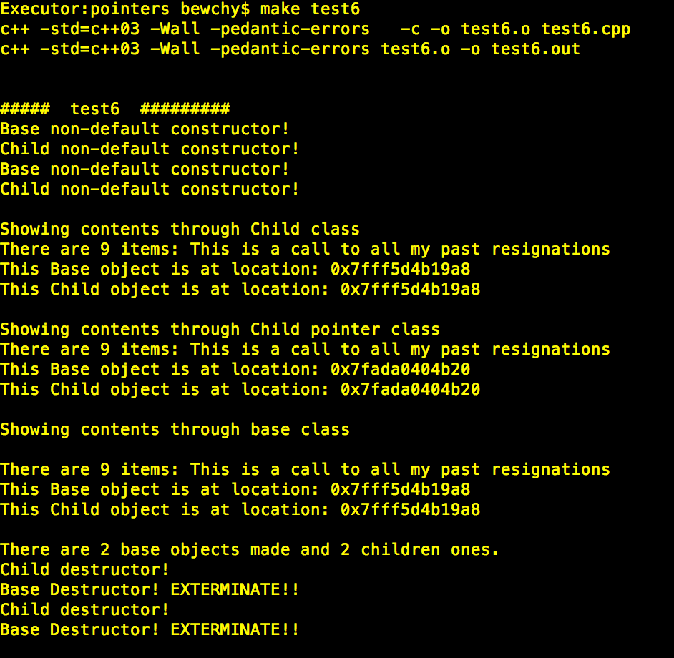

Slide 29
Naked pointers vs containers
Until now we have talked about “naked pointers” aka “old school pointers”
IF you chose to use naked pointers and allocate space yourself, remember that it is YOUR job to clean it up (collect your own garbage!)
If you are trying to store data in memory, avoid using raw pointers / arrays. Use containers instead!
They handle memory themselves
Will grow/shrink as needed
Will get deleted for you (unless you allocated a pointer to a container, in which case you still need delete)
So PLEASE use things like vector, deque, list, stack, queue, priority_queue, set, multiset, map, or multimap

Slide 30
More Pointers Danger
NEVER delete a stack variable / object / array
NEVER delete something that is not a pointer
NEVER assume pointers are initialized for you
If you own a pointer, delete it when done with it! This includes pointers you did not allocate but were created for you by other functions
Watch out for pointer arithmetic errors!
If you pass a pointer to a function, by default you are sending a copy of that pointer
If you have the choice between passing data by reference or passing a pointer to your data, send by reference!
If you make a copy of a pointer, don’t delete it twice! delete gets rid of the pointee, not the pointer!
If you need data in the Heap, consider using a container or make a class that will take care of the data with a proper constructor and destructor

Slide 31

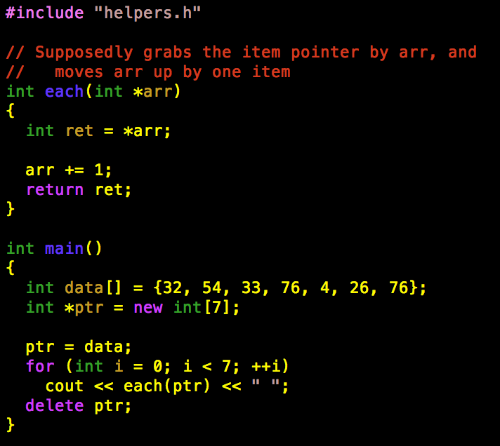
Quiz! Find the bugs!
arr is a copy of the pointer ptr, so changes to arr don’t affect ptr
Adding one to a pointer will place your pointer 1B into the first number, rather than going to the next number in the array
There’s a memory leak caused by the allocation of ptr followed by the overwriting of the pointer with the data array
The delete is wrong!
It has nothing to do with delete []
Since you overwrote ptr with data, now ptr refers to a stack array so DON’T DELETE IT!
We need a return statement in main!

Slide 32
A peek into the “future”
To avoid many of the problems you can get from using raw pointers, C++11 introduced “smart pointers”
unique_ptr<type>
Prevents the pointer from being copied
shared_ptr<type>
Only gets deleted with ALL copies of the pointer are no longer needed/used
weak_ptr<type>
Created as a copy of a shared_ptr that won’t affect the other shared_ptr, but will get erased when the shared_ptr it came from gets deleted
Note that C++03 has auto_ptr
This was removed in C++11 and in order to future-proof your code, you should avoid using it!

Slide 33
Questions?

